Slide 1
Week 4-8
Dr. Mbira

Slide 2
Also known as the embryonic period.
During this period, the embryo goes from a disc into the form that resembles the fully matured fetus at 9 months, i.e it develops the precursors of all the organs and organ systems which then further mature during the fetal period from 2 months to 9 months.
There is also the process of folding of the embryo and formation of a knew space/cavity, the intraembryonic cavity/coelom.
The formation of the organs(organogenesis) is derived from the 3 germ layers of the trilaminar germ disc.

Slide 3
Neurulation
The cells above the notochord become induced form a thickened plate called the neural plate whose edges become elevated to form neural folds with a depressed region centrally called the neural groove.
As the 3rd week transitions to the 4th week the neural folds start fusing in the midline at the region of the 5th somite then proceeds cranially and caudally converting the neural folds and groove into a neural tube.
The cephalic and caudal ends of the neural tube are not fused and remain open-ended communicating with the amniotic cavity. These open ends are called neuropores ; cranial and caudal neuropores.

Slide 4
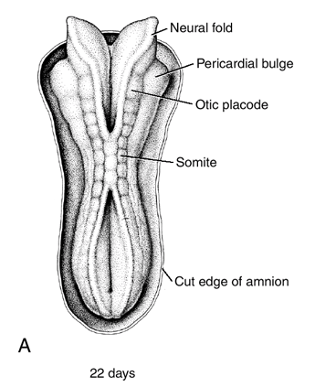
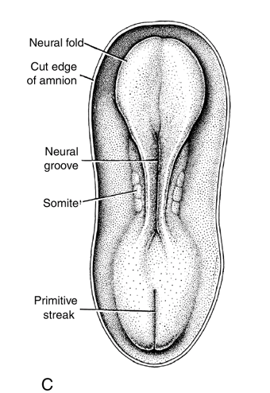
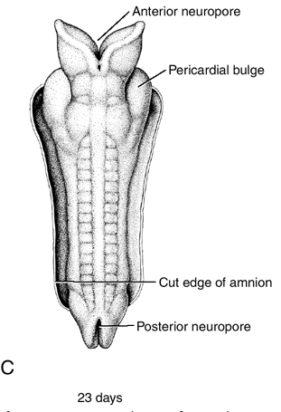

Slide 5
The cranial neuropore closes at day 25 while the caudal neuropore closes at day 27. This marks the end of neurulation.
At this time the CNS is represented by the neural tube whose cranial end are the brain vesicles and the narrow caudal end the spinal cord.
As the neural folds are fusing, the cells at the crest of the folds break off as neural crest cells and migrate into underlying mesoderm.
These cells will migrate both dorsally through the ectoderm again and ventrally through each somite.

Slide 6
Neural crest cells which migrate dorsally through the ectoderm will enter it and become melanocytes.
Neural crest cells which migrate ventrally through each somite will become:
Sensory ganglia
Sympathetic neurons
Enteric neurons
Cells of the adrenal medulla
Neural crest cells which migrate from the cranial region of the neural folds will become:
Ganglia for cranial neurons
Glial cells
Part of craniofacial skeleton

Slide 7
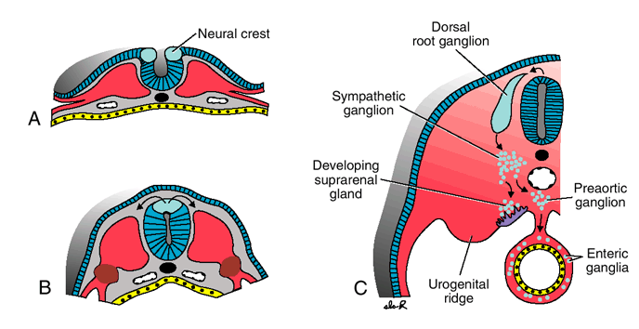

Slide 8
At the same time as the neural tube is fusing and closing the neuropores, there appears 2 bilateral bulges in the ectoderm cranial region of the embryo.
One of these swellings is the otic placode which will form the ear and the other is the lens placode which will form the eye (specifically the lens of the eye).

Slide 9
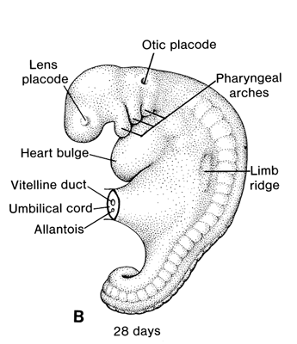

Slide 10
The ectoderm generally gives rise to structures/organs which help the body interact with the external environment:
CNS
PNS
Sensory epithelium of ear, nose, eye
Epidermis and its appendages.
Also the subcutaneous glands, mammary glands, pituitary gland and enamel of teeth.

Slide 11
Mesoderm
Towards the end of the 3rd week it will have divided into the paraxial mesoderm, intermediate mesoderm and the lateral plate/lateral mesoderm.
The lateral mesoderm will divide into 2; parietal/somatic and splanchnic/visceral mesoderm.
Through lateral folding of the embryo, the 2 layers of the lateral mesoderm will come to line the newly formed intraembryonic coelom together with endoderm.

Slide 12
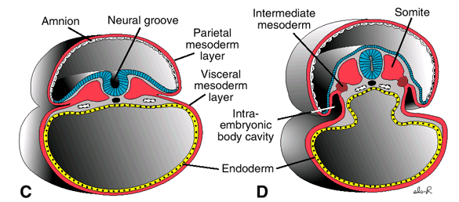
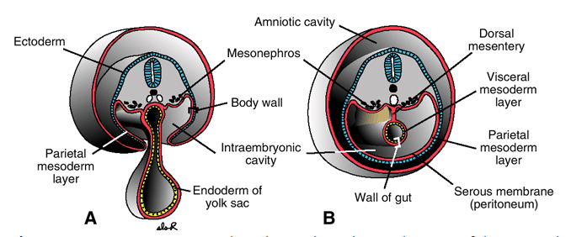

Slide 13
The paraxial mesoderm starting from the 3rd week forms somites which will eventually reach about 44 pairs by week 5.
4 occipital
8 cervical
12 thoracic
5 lumbar
5 sacral
8-10 coccygeal
The 1st occipital and the last 5-7 coccygeal will disappear and the remaining somites will form the musculoskeletal structures of the axial skeleton.

Slide 14
From beginning of the 4th week, the cells in the somites rearrange themselves to form:
Sclerotome
Myotome
Dermatome
Some of the cells of the dorsolateral portion of the somite also migrate to become the precursors of the limbs as well as body wall musculature.

Slide 15
The sclerotome from each somite will form the bones and tendons of the axial skeleton.
The myotome will form axial musculature.
The dermatome will form the dermis and subcutaneous tissues.
Also, each myotome and dermatome will migrate with its own nerve supply from the developing spinal cord which it will retain no matter where it migrates to.

Slide 16
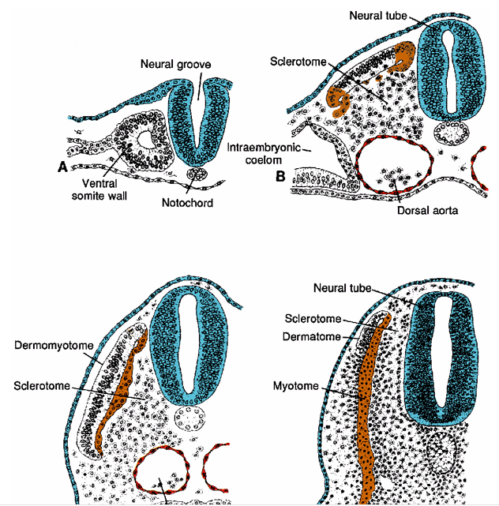

Slide 17
Intermediate mesoderm will form the future urogenital structures.
The lateral mesoderm will form the parietal and visceral layers that will eventually cover the intraembryonic coelom/cavity.
The parietal layer will line the inside of body cavities and form a mesothelial lining that is capable of producing serous fluid.
The visceral layer will line organs.

Slide 19
Endoderm
The GIT and its appendages is the main organ system that is derived from endoderm.
As the embryo grows, its folds cephalocaudally as well as laterally.
The cephalocaudal folding leads to incorporation of the endoderm into the body of the embryo to form a tube that communicates with the yolk sac which by this time is continually decreasing in size relative to the increasing amniotic cavity.

Slide 20
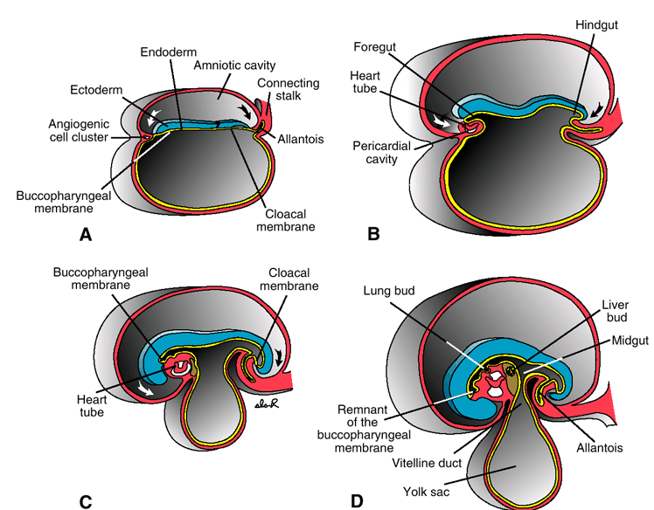

Slide 21
This endoderm lined tube is divided into 3 craniocaudally; foregut, midgut and hindgut.
The midgut communicates with the yolk sac via the vitelline duct which is initially broad but narrows as the embryo grows.
The buccopharyngeal membrane breaks down in the 4th week to establish a connection between the GIT and the amniotic cavity while the cloacal membrane breaks down in the 7th week to establish an anus.
By the end of the 5th week, the vitelline duct, allantois and cloaca are held together in the region of the umbilical ring.
With time, the yolk sac becomes a vestigial structure and its connection with the midgut is obliterated.

Slide 22
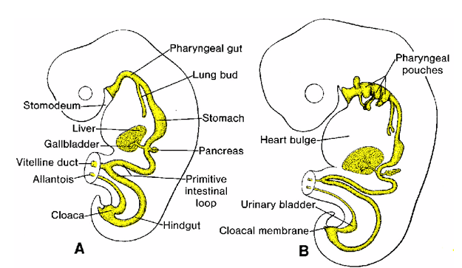

Slide 23
The derivatives of the endoderm:
GIT
Epithelial lining of the respiratory tract.
Epithelial lining of the bladder and urethra.
Epithelial lining of the tympanic and auditory tubes.
Parenchyma of the thyroid and parathyroids.
Stroma of the tonsils and thymus

Slide 24
Externally, from the 5th week will be seen limb buds forming, as well as eyes, ears and nose.
Also the head increases significantly in size due to underlying brain development.
The limb buds will further differentiate to form limbs.
At the end of 8 weeks, the embryo will have an obviously recognizable human form.
This period of organogenesis is very delicate and any disturbance can lead to congenital defects.

Slide 25
